Slide 1

*Match adjectives (1-5) in column A to definitions (a-e) in column B.
B
A
so surprising that it is difficult
to believe
1. located
2. picturesque
b. in a particular position or place
c. relating to the work of managing
a country or an institution
3. astounding
4. geological
d. pretty and unchanged by time
5. administrative
e. relating to the rocks that make
up the Earth's surface

Slide 2

Welcome all of teachers and students
UNIT 5: WONDERS OF VIET NAM
Lesson 7: Looking back & project
Lesson plan for English 9

Slide 3
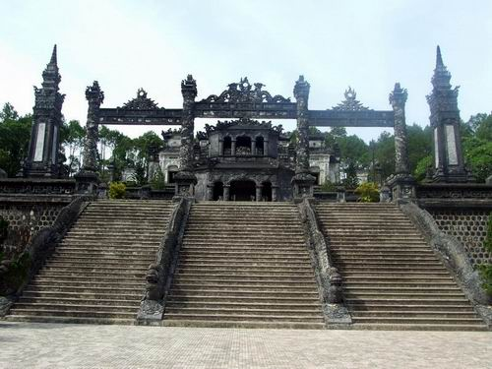
2. Underline the correct word in each sentence.
1. A fortress/cathedral is a building that has been
made stronger and protected against attack.
2. From Port Eynon, the cement/limestone cliffs
extend for five or six miles to Worms Head.
3. A cavern/bay is a cave that is big enough for
humans to go inside.
4. Hue's most outstanding attractions are the
emperors' tombs/graves.

Slide 4
3. Use the words from the box to complete the sentences.
setting
complex
structure
measures
recognition
1. The new leisure ____________ includes a swimming pool, a sauna, and a gym.
2. There are ____________ in place to reduce the damage to man-made wonders.
3. Hoi An town gained UNESCO's ____________ as a World Heritage Site in 1999.
4. The pagoda is located in a rural____________. 5. The ____________has been restored over the years.
complex
measures
recognition
setting
structure

Slide 5
4. Rewrite the following sentences using the impersonal passive.
They expect more than 100,000 people will attend the festivals at the Perfume Pagoda this year.
- ______________________________________________
2. People have reported that Thien Duong is the longest cave in Viet Nam.
- ______________________________________________
3. People believe the Perfume Pagoda was built during the reign of Le Thanh Tong in the 15th century.
- ______________________________________________
4. People say Ha Long Bay is one of the most extraordinary natural wonders you will ever see.
- ______________________________________________
5. People hope many defensive measures will be taken to protect and preserve our man-made wonders.
- ______________________________________________
It is expected that more than 100,000 people will attend the festivals at the Perfume Pagoda this year.
It has been reported that Thien Duong is the longest cave in Viet Nam.
It is believed that the Perfume Pagoda was built during the reign of Le Thanh Tong in the 15th century.
It is said that Ha Long Bay is one of the most extraordinary natural wonders you will ever see.
It is hoped that many defensive measures will be taken to protect and preserve our man-made wonders.

Slide 6
5. Imagine four bad things that happened to you yesterday, and ask your partner what you should do in each situation.
Example: A: I failed the English test. What should I do?
B: I suggest you should watch more TV in English.
1. A: I lost my wallet. What should I do?
B: ………………………………
2. A: My motorbike was breakdown. What should I do?
B: …………………………………………………
3. A: My bike was stolen. What should I do?
B: ………………………………………
4. A: I have had a headache for 2 days. What should I do?
B: …………………………………………
I suggest reporting to the police.
I suggest you should take it to a shop for repair.
I suggest you should call the police.
I suggest you should go to the hospital.

Slide 7
6. In pairs, make travel suggestions using the prompts and respond to them.
Prompts | Responses
It’s well worth going to the… | That’s good to know.
You should definitely see the … | Yes, that’s what I’ve heard.
Don’t bother buying… | Thanks, that’s really useful.
It’s probably best to go by… | That sounds good/better.
You really must go to…
Example:
A: It's well worth going to the Perfume Pagoda.
It's very picturesque.
B: Yes, that's what I've heard.

Slide 8
7. Choose A-F to complete the following conversation. Practice the conversation with your partner.
A. In Delhi it's probably best to use rickshaws.
They're quicker than taxis, and quite cheap.
B. Er no, don't bother going to the museums.
There are much better things to see in Delhi.
You should definitely see the Red Fort, in Old
Delhi it's vast.
C. And to travel to other cities I'd recommend
the trains. They're a lot safer than the buses,
especially at night.
D. Sure. What do you want to know?
E. Yes, I have, actually. It's an amazing place.
F. There are lots of good .hotels in Connaught
Place - that's right in the center of New Delhi.
The place I always stay in is called The Raj
Hotel. I can give you the address if you like.
Mi: (2)______________________.
Phong: Well, firstly, do you know any good places to stay in?
Mi: (3)_____________________.
Phong: Great, thanks. And what's the best way to get around?
Mi: (4)_____________________.
Phong: OK
Mi: (5)_____________________.
Phong: Hmm, that's good to know. So what are the things I shouldn't miss any good museums?
Mi: (6)_____________________.
Phong: Right. Is there anything else worth visiting?
D
F
A
C
Phong: Mi, you've been to Delhi, haven't you?
Mi: (1)___________________________.
Phong: Oh, good. I'm going there next week.
Maybe you can give me some tips.
B
E

Slide 9

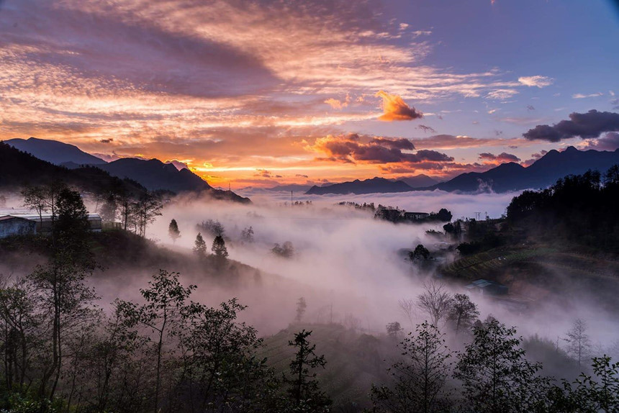
2. Find a photo or draw a picture of a wonder of Viet Nam you have visited. Create a similar promotional brochure about it.
Welcome to the Ta Van valley in Sa Pa town where attracts visitors thanks to its primitive natural landscapes and mesmerizing terraced fields embracing villages!
You will certainly be impressed with terraced rice fields that look like trays of steamed sticky rice or shoe soles during ripe season in Che Cu Nha commune, Mu Cang Chai disitrct. During the harvest, terraced fields form rolling waves rising to the peak of the mountain. Mong, Dao, Tay, Nung, La Chi ethnic people make water pipes from bamboo poles to divert water from streams to fields or from higher fields to lower ones. After harvesting rice, Nung people in Po Lo commune (Hoang Su Phi, Ha Giang) use mangers to thresh rice in the field.
Nowadays, the Nung people in Po Lo commune (Hoang Su Phi) still keep the custom of exchanging labor during the harvest season. The Red Dao people in Hoang Su Phi district believe that the spirit of each grain of rice can call 1,000 grains to their baskets, resulting in measureless rice for people.
Don’t miss out on a visit to the terraced rice fields in Sa Pa town where is the peak of beauty crystallised by Vietnamese culture and labour. Its beauty and friendly ethnic people here will make your trip unforgettable.

Slide 10

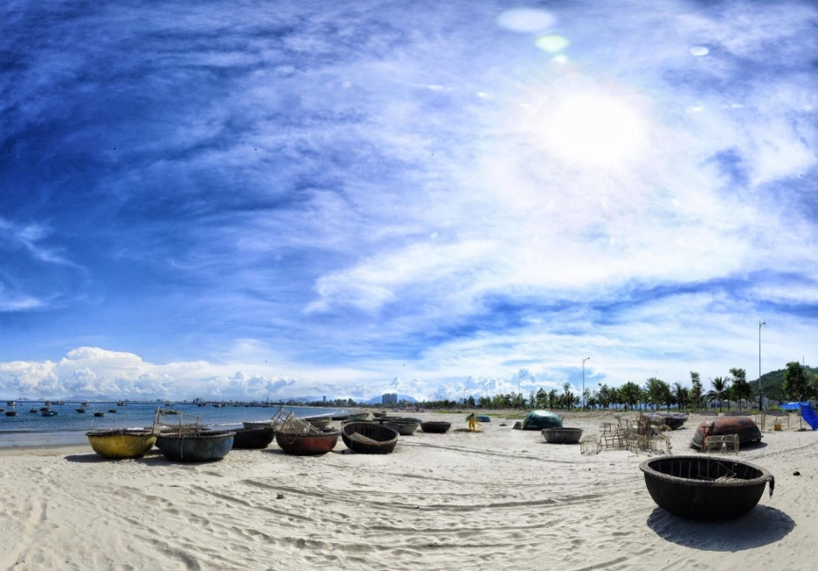
2. Find a photo or draw a picture of a wonder of Viet Nam you have visited. Create a similar promotional brochure about it.
My Khe Beach is one of the most attractive spot in Da Nang city. My Khe Beach is very beautiful with blue sky, warm water, white sand, so Forber Magazine selected it as "one of the most attractive on the planet" title.
Because it's just 5km to get here from DN center, you can go there by many transports such as by car, by bike, walk or by bus...
There is peaceful, natural, very clean, and also has free admission, great accommodations, that's why many people choose My Khe Beach for their voyage.
My Khe Beach is an ideal and safe place for everyone to swim anytime of year with large waves and warm water. It's a good idea to enjoy the stunning view of dawn and gloaming on the beach
Alongside the long of the beach has many luxury and affordable hotels, restaurants to serve visitors. If you like traveling, I really recommend you to visit My Khe Beach one time.

Slide 11

HOMEWORK
write a short article describing a wonder of Viet Nam
Prepare Unit 6 : Getting started

