Slide 1
London, Tokyo, Shanghai, Manila, Jakarta

Slide 2
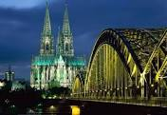
LONDON

Slide 3
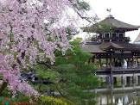
TOKYO

Slide 4
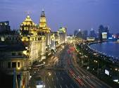
SHANGHAI

Slide 5
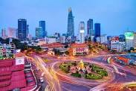
MANILA

Slide 6
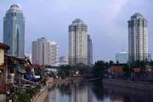
JAKARTA

Slide 7
Match the city with the country
Philippines Japan England
Vietnam China Laos
Indonesia
CITY | COUNTRY
London
Shanghai
Tokyo
Manila
Vientiane
Hanoi
Jakarta
England
China
Japan
Philippines
Laos
Vietnam
VietNam
Indonesia

Slide 8
Unit 12: An overcrowded world
Lesson 4: Skills 1

Slide 9
1. New words
- issue ( n ) : topic of interest or discussion, :
- Megacity (n) siêu đô thị
- Growth(n) sự lớn lên, sự phát triển
- Traffic block
=Traffic jam
- explosion(n) sự bùng nổ

Slide 10
Matching
issue
explosion
growth
megacity
traffic block
kẹt xe
Sự đưa ra
Siêu đô thị
Sự bùng nổ
sự lớn lên, sự phát triển

Slide 11
List the cities from the biggest to the smallest:
London, Tokyo,Shanghai, Jakarta,
Manina.

Slide 12
2. Read
Read the passage below and check your answer
People from the countryside move to cities to find work and better standard of living. These cities are so large they have been named megacities. The largest is Tokyo, followed by Shanghai, Jakarta, and Manila. Some way behind is London, with a relatively small 15 million people.

Slide 13
Key :
Tokyo
Shanghai
Jakarta
Manila
London

Slide 14
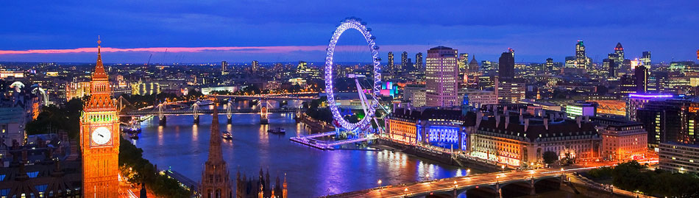
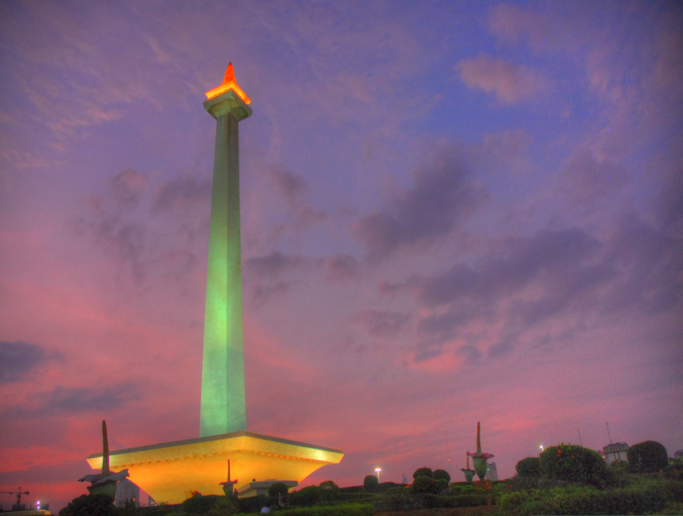
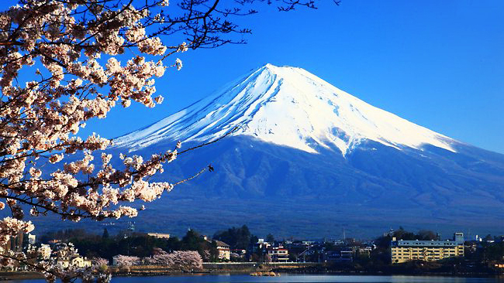
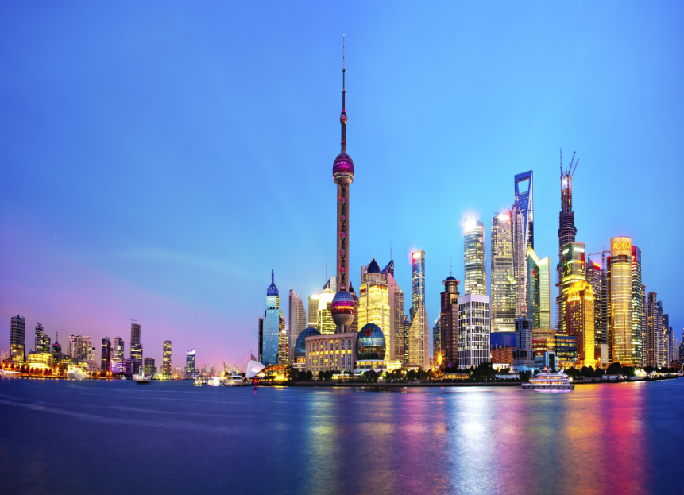
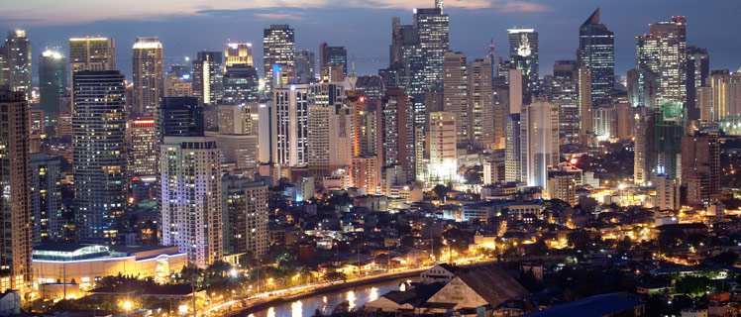
London: 1577,3 km²
Jakarta: 661,52 km²
Tokyo: 2,190,90 km²
Shanghai: 6,340,5 km²
Manila: 38,55 km²

Slide 15
a. Read the passage again. Choose the correct heading for each paragraph.
The rise of megacities!
1. _____________________________________
Chances are, you are reading this article in a big city. Population growth is far faster than ever before and that is especially true in cities like Tokyo and Shanghai.
2. _____________________________________
People from the countryside move to cities to find work and a better standard of living. These cities are so large they have been named megacities. The largest is Tokyo, followed by Shanghai, Jakarta, and Manila. Some way behind is London, with a relatively small 15 million people.
_____________________________________
However, life in cities is not always better. Homelessness is a big problem. When people do have homes, they are often in slums where disease and poor healthcare are problems.
_____________________________________
Problems affect richer people too. Traffic blocks roads for hours in cities like Bangkok and Mexico City. Air pollution is so bad in some cities that people do not want to go out.
Population explosion
Which are the biggest?
Problems for the poor
Issues for everyone

Slide 16
b. Read the passage again and choose the best answer A,B, or C

Slide 17




Ms Phương
Zalo: 0966765064

Slide 18
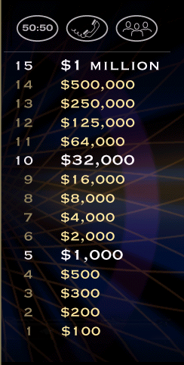
Ms Phương
Zalo: 0966765064

Slide 19
Ms Phương
Zalo: 0966765064

Slide 20





1.The world’s population is...........
Ms Phương
Zalo: 0966765064
50/50
A. Growing slowly
B. Staying the same
C. Growing quikly

Slide 22
2. Tokyo has......................people
Ms Phương
Zalo: 0966765064
50/50
A. below 15 million
A. below 15 million
B. around 15 million
C. much more than 15 million

Slide 23
Ms Phương
Zalo: 0966765064

Slide 24
3. Problems in big cities affect...........
Ms Phương
Zalo: 0966765064
50/50
A. Poor people
B. People who live in slums
C. Everyone

Slide 26
4. Some problem that poor people face in cities include....
50/50
A. Traffic and air pollution
B. Healthy problems and stress
C. Having no home or living in slums
C. Having no home or living in slums

Slide 27
Ms Phương
Zalo: 0966765064

Slide 28
5. When air pollution is bad, people.........
50/50
A. Only go out at night
B. don’t go out
B) don’t go out
C. Move to smaller cities

Slide 29
Ms Phương
Zalo: 0966765064

Slide 30

Ms Phương
Zalo: 0966765064
Congratulations!
Thank you for playing
Notes:
Correct

Slide 31
Key:
1. C 2.C 3.C 4.C 5. B

Slide 32
3. Write
There / not / enough/ space/ children/ pay
Traffic jam/ happen
There/ a shortage / water / electric/ supplies
The environment / polluted

Slide 33
NETWORKS
not enough study aids
big classes
An overcrowded
school
not enough playing ground
less individual care

Slide 34
NETWORKS
not enough study aids
big classes
An overcrowded
school
not enough playing ground
less individual care

Slide 35

HOMEWORK
Ms Phương
Zalo: 0966765064
Pronunciation: Stress the first syllable for most two - syllable adjectives.
- Practice speaking: What was on at the movies with your classmates.
- Do homework: Grammar/ writing on page 41/ (workbook)

Slide 36



BÀI GIẢNG THUỘC QUYỀN SỞ HỮU TRÍ TUỆ CỦA E-TEACHERS. NGHIÊM CẤM MỌI HÀNH VI SAO CHÉP, PHÁT TÁN CHIA SẺ , MUA ĐI BÁN LẠI KHI CHƯA ĐƯỢC SỰ ĐỒNG Ý CỦA E-TEACHERS
PHONE /ZALO: 0966765064 – MS PHƯƠNG
https://www.facebook.com/maiphuongdo.dhnn/
SỬ DỤNG TÀI LIỆU CHÍNH CHỦ BẠN SẼ NHẬN ĐƯỢC SỰ TẬN TÂM VÀ CHÚNG TÔI SẼ PHỤC VỤ CÁC BẠN TẬN TÌNH.
TÀI LIỆU ĐƯỢC UPDATE VÀO MAIL CÁ NHÂN NGAY KHI UPDATE VÀ ĐƯỢC GIẢI ĐÁP MỌI THẮC MẮC VỀ KỸ THUẬT HOẶC CHUYÊN MÔN MỘT CÁCH KỊP THỜI NHẤT.
ỦNG HỘ CÔNG SỨC LAO ĐỘNG CỦA ĐỒNG NGHIỆP CHÍNH LÀ ĐANG GIEO NHÂN QUẢ TỐT.
BUÔN BÁN TRÊN CÔNG SỨC CỦA NGƯỜI KHÁC LÀ HÀNH ĐỘNG CẦN TẨY CHAY VÀ LÊN ÁN.
TK: 3614689 ĐỖ MAI PHƯƠNG
NGÂN HÀNG VPBAK VIÊT NAM THỊNH VƯỢNG CHI NHÁNH HÀ NỘI.

