Slide 1
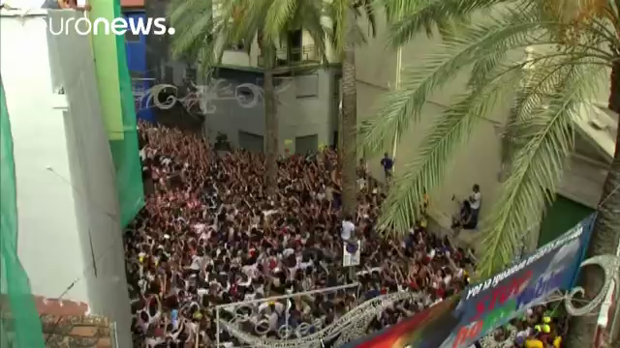
what festival is it?
La Tomatina Festival in Spain

Slide 2
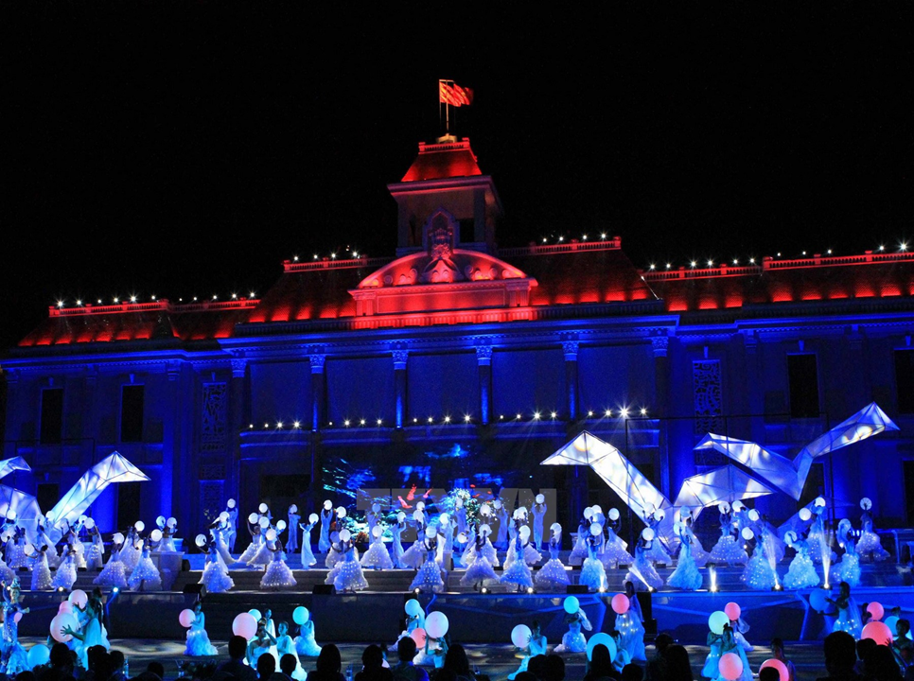
Festival Bien – Nha Trang
Unit 9-Lesson 4: skills 1

Slide 3
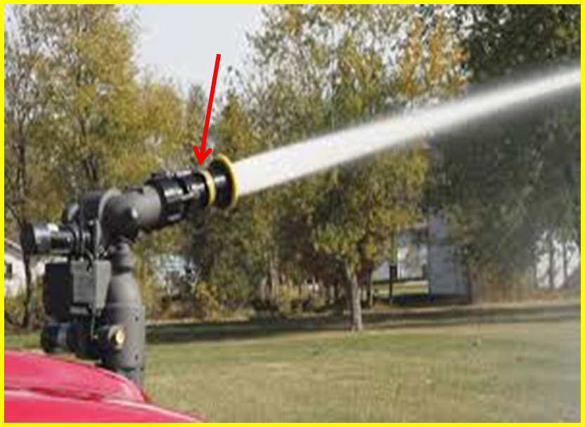
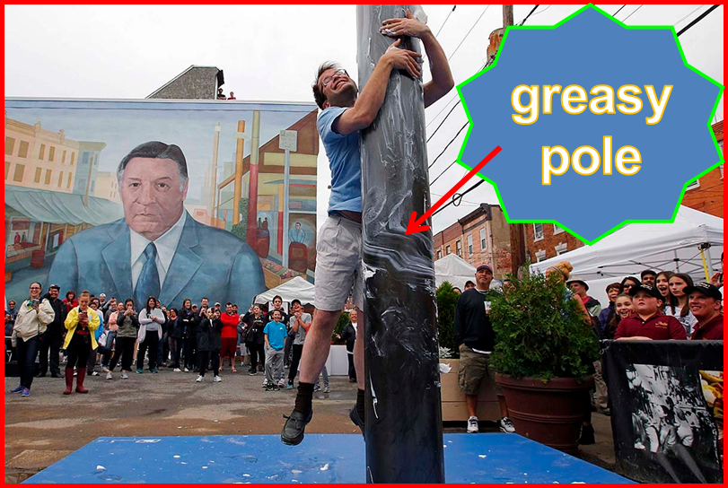
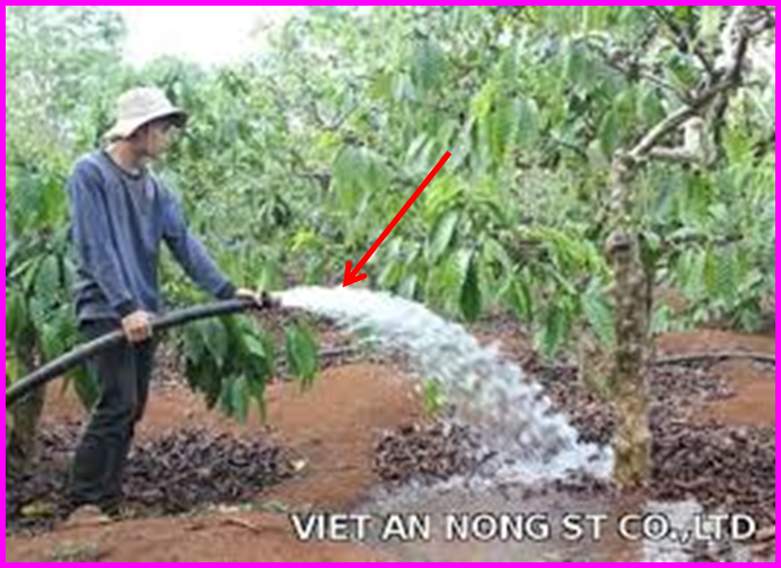
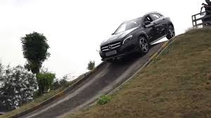
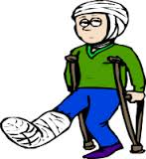
I.Vocabulary
greasy (a)
pole (n)
jet of water (n)
water cannon (n)
chaos (n)
steep (a)
get injured (v)
organizer (n)
trơn tuột, nhờn
cây cột, cây sào
tia nước, vòi nước
vòi rồng, vòi phun nước
sự hỗn loạn, sự lộn xộn
dốc
bị thương
nhà (người) tổ chức

Slide 4
Checking vocabulary
greasy (a)
pole (n)
jet of water (n)
water cannon (n)
chaos (n)
steep (a)
get injured (n)
organizer (v)
trơn tuột, nhờn
cây cột, cây sào
tia nước, vòi nước
vòi rồng, vòi phun nước
sự hổn loạn, sự lộn xộn
dốc
bị thương
nhà (người) tổ chức

Slide 5
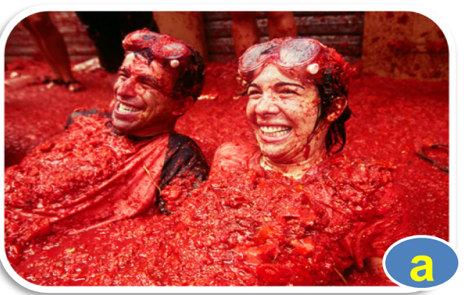
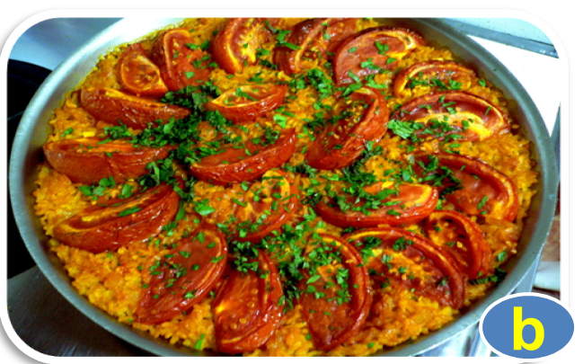
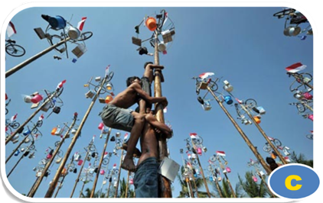
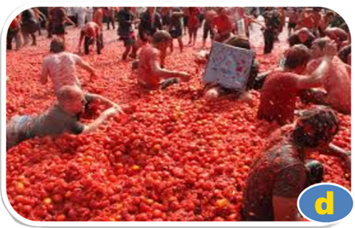
1. In pairs, look at the pictures below. They are all from the La Tomatina Festival in Spain. Put them in the order you think they happen at the festival.

Slide 6
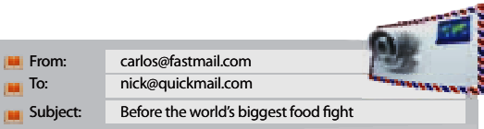
2. Now quickly read the texts below and check your answers.
Hi Nick,
My family and I arrived in Buñol, Spain yesterday. It‛s the town where La Tomatina is held on the last Wednesday of August every year. There are thousands of people here. Luckily, the weather has been wonderful.
We stayed up late, but got up early this morning to
attend the festival. We saw that some people had
already placed the ham on top of the greasy pole. I have to go now.
Carlos

Slide 7

Nick,
Yesterday was the most exciting day of my life! In the morning, many people tried to climb up the pole to get the ham. At 11 a.m. we saw a jet of water coming from the water cannons and the chaos began. Bags of tomatoes from trucks were thrown to the crowds, and we began throwing tomatoes at one another. We all had to wear goggles to protect our eyes.
After one hour, we saw another jet of water and stopped throwing. The whole town square was red with rivers of tomato juice. Finally, we tried tomato Paella, a traditional Spanish rice dish. Together with local people and tourists, we enjoyed the good food and drinks.
I‛m still tired, so bye for now.
Carlos

Slide 8
1. Put pictures in the order you think they happen at the festival.
1
2
3
4

Slide 9
4. Read the texts again and answer the questions.
1. When is La Tomatina celebrated?
2. What did Carlos do the day before the festival?
3. What did people place on top of the greasy pole?
4. Why did they have to wear goggles?
5. What was the signal for the start and end of the tomato fight?
6. How was the town square after the fight?
Back

Slide 10
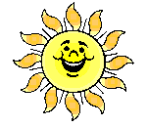
LUCKY NUMBER
1
9
2
Team A
8
Team B
3
20
50
60
40
30
10
70
00
20
30
40
00
10
50
60
70
7
4
6
5
NEXT

Slide 11


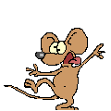
Lucky Number
Lucky Number
You get 10 marks
BACK

Slide 12
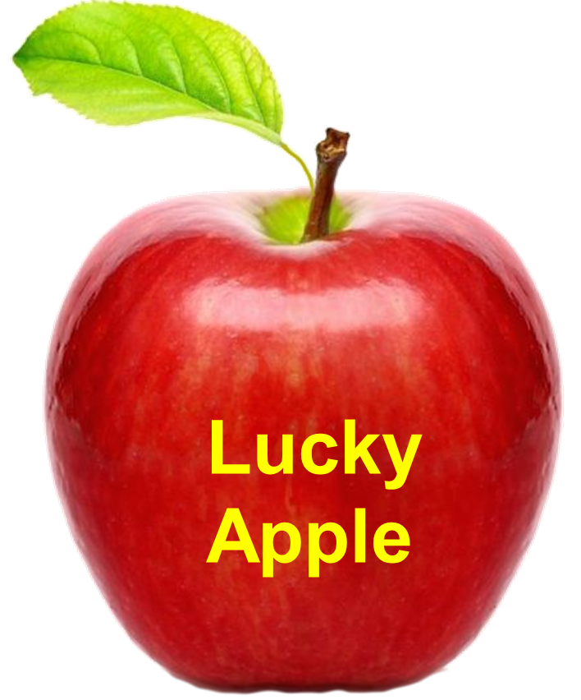
You get 15 marks
BACK

Slide 13

You lose 10 marks
BACK

Slide 14
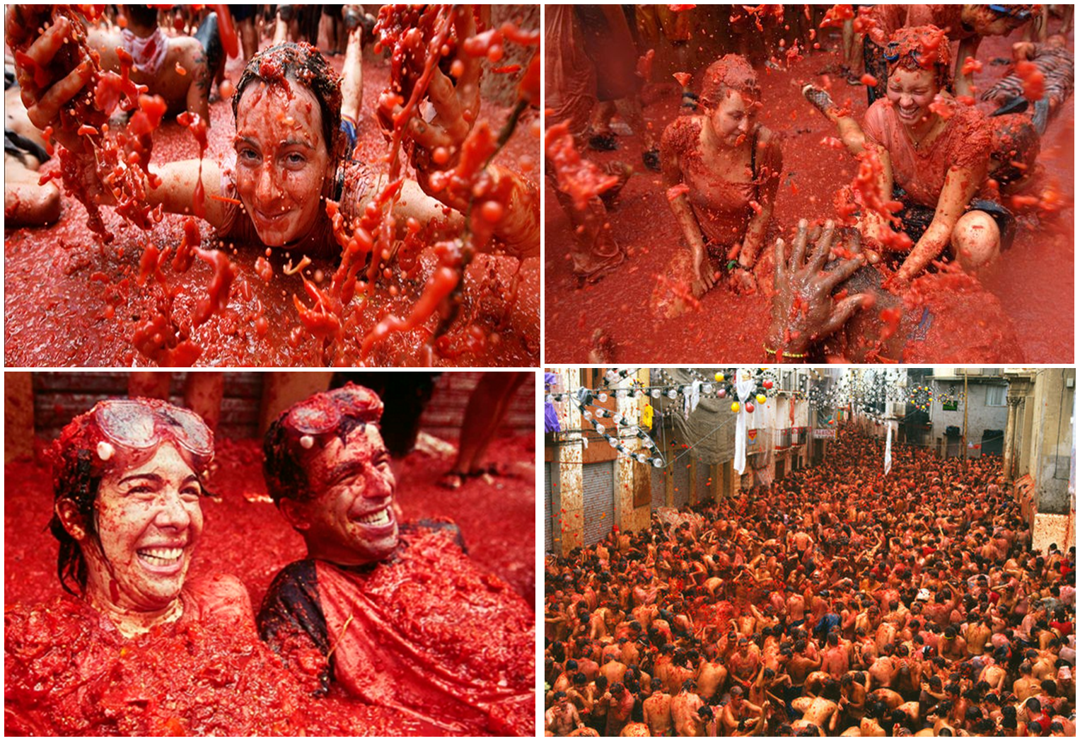
1. When is La Tomatina celebrated?
It is celebrated on the last Wednesday every August.
BACK

Slide 15
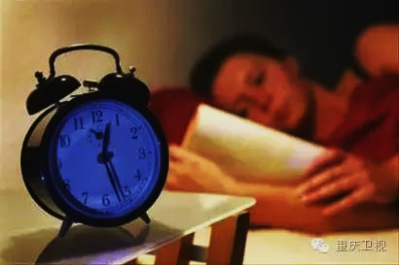
2. What did Carlos do the day before the festival?
He stayed up late.
BACK

Slide 16
3. What did people place on top of the greasy pole?
They placed the ham on top of the greasy pole.
BACK

Slide 17
4. Why did they have to wear goggles?
They had to wear goggles to protect their eyes.
BACK

Slide 18
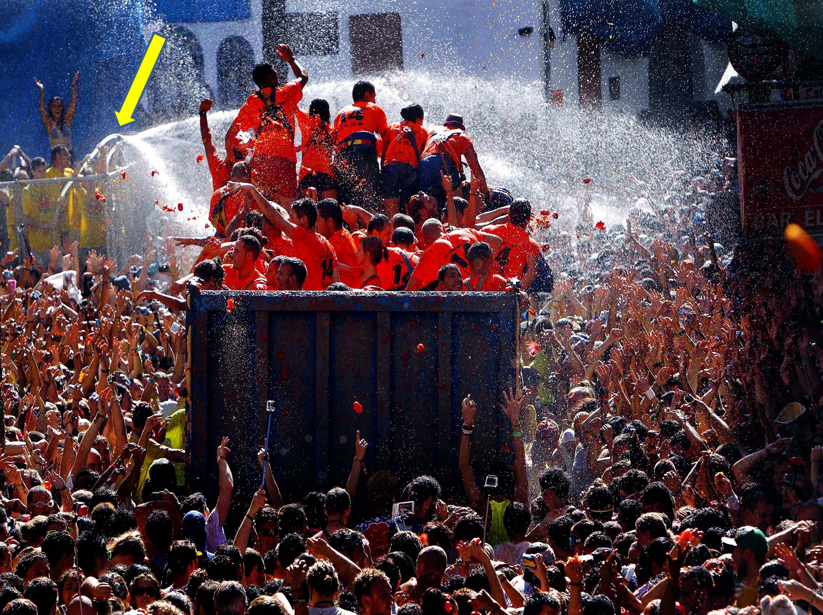
5. What was the signal for the start and end of the tomato fight?
It was a jet from water cannons.
BACK

Slide 19
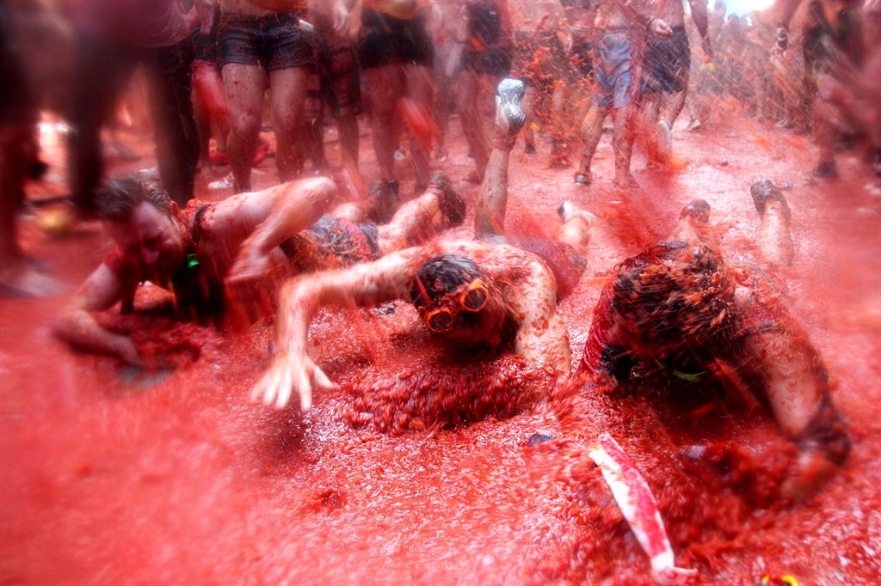
6. How was the town square after the fight?
It was red with rivers of tomato juice.
BACK

Slide 20
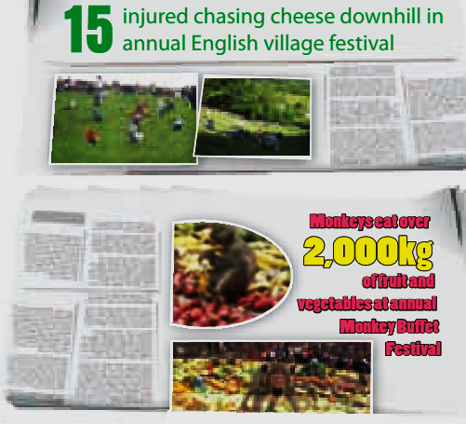
4. Work in groups. Look at the newspaper headlines about two unusual festivals around the world. Discuss what you think is unusual about them.

Slide 21
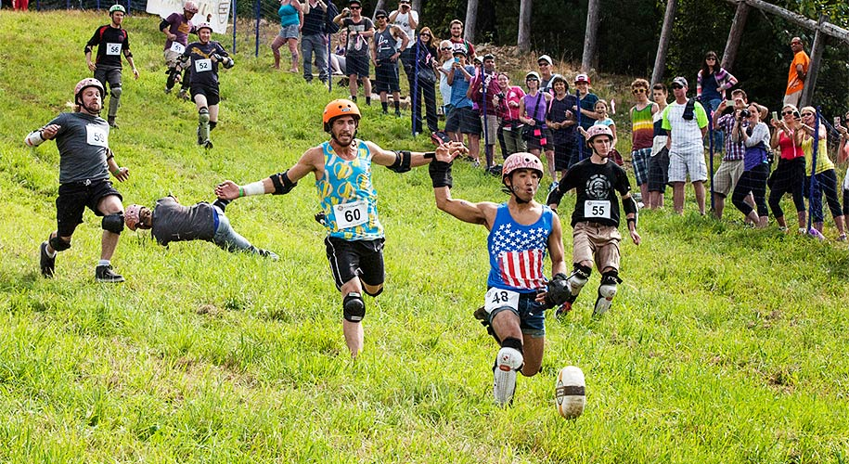
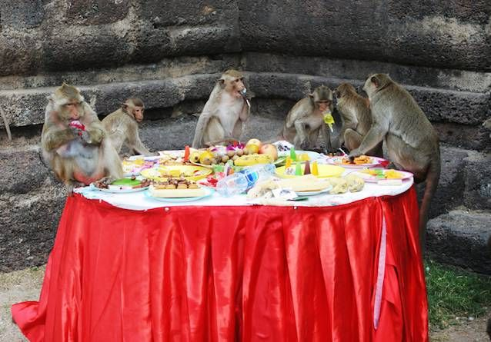
- The cheese rolls very fast (about 30 – 70 miles per hour)
- It’s very dangerous because the slope is very steep. Participants may get injured.
- Many people from around the world take part in this even every year.
- Monkeys are treated as humans and served with a lot of fruit.
- They are believed to bring good luck to the locals and visitors.

Slide 22
5. Choose one festival to teach your group about. Read the information about your festival. Plan what you will say.
CHEESE ROLLING
What? | seasonal festival; people race downhill to catch cheese
Where? | Cooper’s Hill, Gloucester, England
When? | spring every year
Who? | people from all over the world
Why? | to see who will be first to catch the cheese
How? | with great difficulty – the hill is very steep, and many people get injured

Slide 23
5. Choose one festival to teach your group about. Read the information about your festival. Plan what you will say.
THE MONKEY BUFFET
What? | festival where around 2,000 local monkeys are fed fruit and vegetables
Where? | Pra Prang Sam Yot Temple, north of Bangkok, Thailand
When? | every year
Who? | tourists and local people
Why? | to get more tourists to the area; to celebrate religious story about a monkey
How? | the organisers buy around 2,000 kg of fruit and vegetables

Slide 24
6. Present your festival to your partner. Allow time for them to ask questions at the end.

Slide 25
Model report 1: CHEESE ROLLING COMPETITION
In spring each year on the top of the Cooper's Hill in Gloucester England, people from all over the world gather to take part in the famous seasonal festival called "Coopers Hill Cheese Rolling".
The aim of the competition is to see who will be first to catch the cheese. It also brings joy and honor to participants. The hunk of cheese rolls down the steep hill. Participants chase after and try to catch the cheese, normally the winner catches it after he/she crosses the finish-line at the bottom of the hill because the cheese travels very fast. The prize is the cheese of course.
The event is very dangerous because participants could fall over and get injured, so consider it carefully before getting in the event.

Slide 26
Model report 2: THE MONKEY BUFFET FESTIVAL
The Monkey Buffet Festival is a celebration that takes place in Pra Prang Sam Yot Temple, north of Bangkok, Thailand on November 25th every year. The local peoples believe that monkeys bring good fortune to the visitors. It has been held since 1989.
Nowadays, the festival became a major tourist event and travelers from all over the world come to participate and see around 2,000 local monkeys are fed with around 2,000 kg of fruit and vegetables by the organisers.
The Monkey Buffet Festival is definitely a unique and strange event that will give you a new perspective on how monkeys are treated. It promises a load of fun especially for people who loves animals.

Slide 27

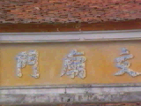
HOMEWORK
- Learn the new words.
- Practice reading the passages again
- Do exercise C1,2 (page 21); D1,2,3 (page 22-23) in workbook.
- Prepare for Unit 9: SKILLS 2
+

Slide 28
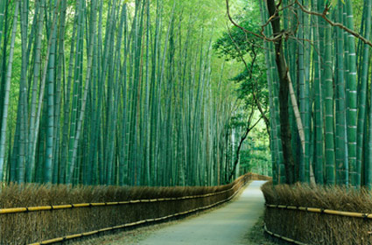
THANKS FOR YOUR ATTENTION!
Goodbye!
See you again!

