Slide 1


WELCOME TO
OUR CLASS!

Slide 2
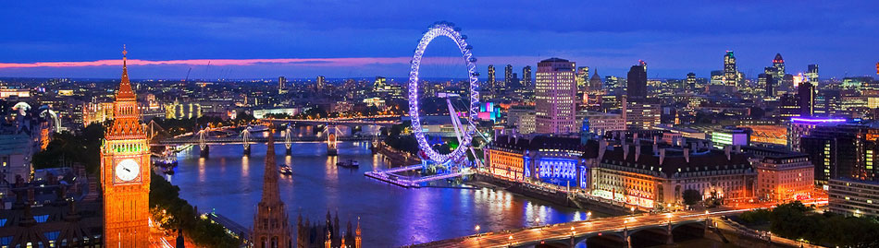
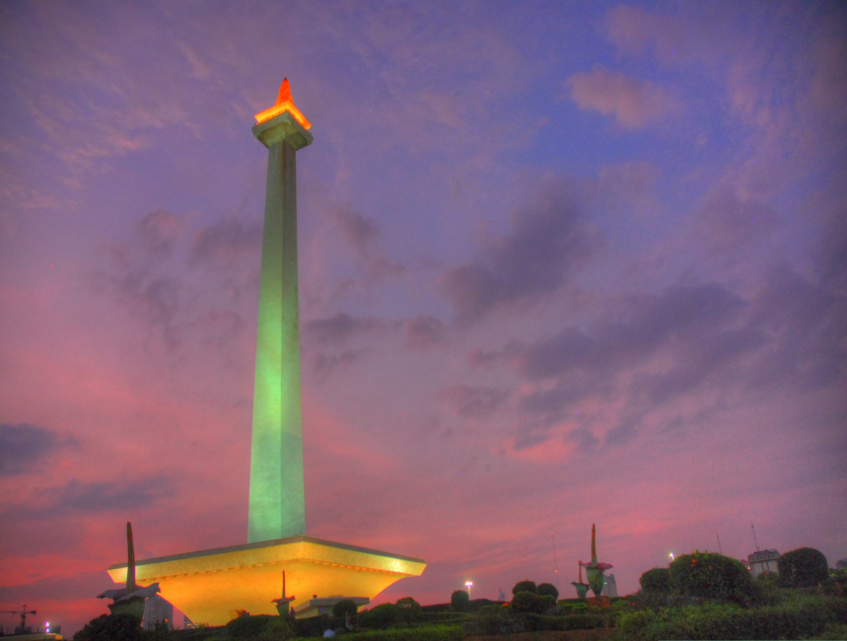
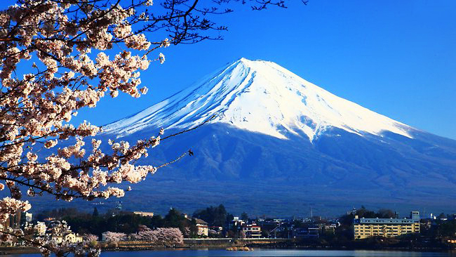
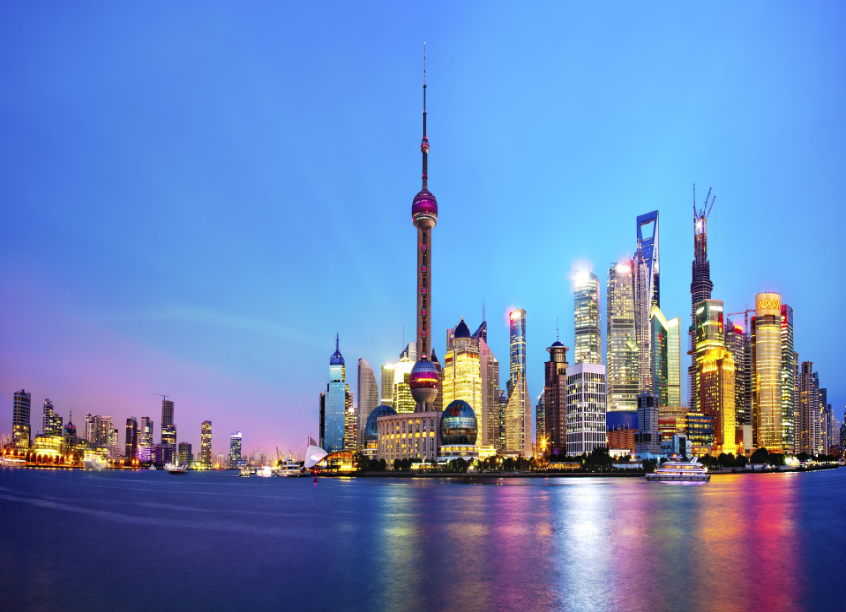
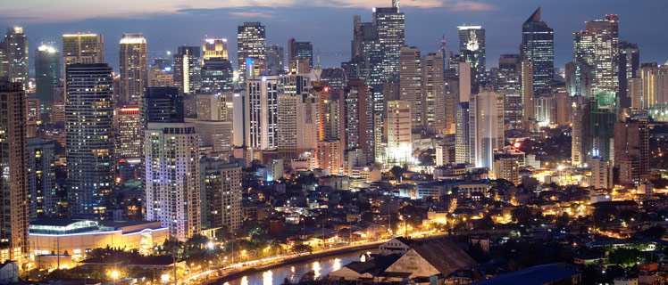
London, Tokyo, Shanghai, Manila, Jakarta

Slide 3
LONDON

Slide 4
TOKYO

Slide 5
SHANGHAI

Slide 6
MANILA

Slide 7
JAKARTA

Slide 8

Match the city with the country
Philippines Japan England
Vietnam China Laos
Indonesia
CITY | COUNTRY
London
Shanghai
Tokyo
Manila
Jakarta
England
China
Japan
Philippines
Indonesia

Slide 9
Unit 12: An overcrowded world
Lesson 4: Skills 1

Slide 10
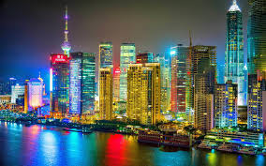
1. New words
- issue
:( n ) sự đưa ra, vấn đề
- megacity
:(n) siêu đô thị
- growth (n): sự lớn lên, sự phát triển
- traffic block
= traffic jam: giao thông tắc nghẽn
- explosion (n) sự bùng nổ

Slide 11
Matching
issue
explosion
growth
megacity
traffic block
kẹt xe
sự đưa ra
siêu đô thị
sự bùng nổ
sự lớn lên, sự phát triển

Slide 12
Read: List the cities from the biggest to the smallest:
London, Tokyo,Shanghai, Jakarta,
Manina.

Slide 13
2. Read
a. Read the passage below and check your answer
People from the countryside move to cities to find work and better standard of living. These cities are so large they have been named megacities. The largest is Tokyo, followed by Shanghai, Jakarta, and Manila. Some way behind is London, with a relatively small 15 million people.

Slide 14
Key :
Tokyo
Shanghai
Jakarta
Manila
London

Slide 15
London: 1577,3 km²
Jakarta: 661,52 km²
Tokyo: 2,190,90 km²
Shanghai: 6,340,5 km²
Manila: 38,55 km²

Slide 16
b. Read the passage again. Choose the correct heading for each paragraph.
A. Issues for everyone
B. Population explosion
C. Problems for the poor
D. Which are the biggest?
1. _____________________________________
Chances are, you are reading this article in a big city. Population growth is far faster than ever before and that is especially true in cities like Tokyo and Shanghai.
2. _____________________________________
People from the countryside move to cities to find work and a better standard of living. These cities are so large they have been named megacities. The largest is Tokyo, followed by Shanghai, Jakarta, and Manila. Some way behind is London, with a relatively small 15 million people.
_____________________________________
However, life in cities is not always better. Homelessness is a big problem. When people do have homes, they are often in slums where disease and poor healthcare are problems.
4._________________________
Problems affect richer people too. Traffic blocks roads for hours in cities like Bangkok and Mexico City. Air pollution is so bad in some cities that people do not want to go out.
B. Population explosion
D. Which are the biggest?
C. Problems for the poor
A. Issues for everyone

Slide 17
c. Read the passage again and choose the best
answer A,B, or C

Slide 18
Ex4. Read the passage again and choose the best answer A, B, or C.
The world’s population is __________.
A. growing slowly
B. staying the same
C. growing quickly
Tokyo has __________ people.
A. below 15 million
B. around 15 million
C. much more than 15 million
Problems in big cities affect __________.
A. poor people
B. people who live in slums
C. everyone
Some problem that poor people face in cities include __________.
A. traffic and air pollution
B. healthy problems and stress
C. having no home or living in slums
When air pollution is bad, people __________.
A. only go out at night
B. don’t go out
C. move to smaller cities

Slide 19




Ms Phương
Zalo: 0966765064

Slide 20
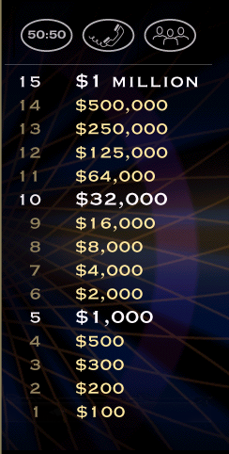
Ms Phương
Zalo: 0966765064

Slide 21
Ms Phương
Zalo: 0966765064

Slide 22




1.The world’s population is...........
Ms Phương
Zalo: 0966765064
50/50
A. growing slowly
B. staying the same
c. Growing quickly

Slide 24
2. Tokyo has......................people
Ms Phương
Zalo: 0966765064
50/50
A. below 15 million
B. around 15 million
C. much more than 15 million
C. much more than 15 million

Slide 25
Ms Phương
Zalo: 0966765064

Slide 26
3. Problems in big cities affect...........
Ms Phương
Zalo: 0966765064
50/50
A. poor people
B. people who live in slums
C. everyone

Slide 28
4. Some problem that poor people face in cities include....
50/50
A. traffic and air pollution
B. healthy problems and stress
C. Having no home or living in slums
C. having no home or living in slums

Slide 29
Ms Phương
Zalo: 0966765064

Slide 30
5. When air pollution is bad, people.........
50/50
A. only go out at night
B. don’t go out
B) don’t go out
C. move to smaller cities

Slide 31
Ms Phương
Zalo: 0966765064

Slide 32

Ms Phương
Zalo: 0966765064
Congratulations!
Thank you for playing
Notes:
Correct

Slide 33
Ex4. Read the passage again and choose the best answer A, B, or C.
The world’s population is __________.
A. growing slowly
B. staying the same
C. growing quickly
Tokyo has __________ people.
A. below 15 million
B. around 15 million
C. much more than 15 million
Problems in big cities affect __________.
A. poor people
B. people who live in slums
C. everyone
Some problem that poor people face in cities include __________.
A. traffic and air pollution
B. healthy problems and stress
C. having no home or living in slums
When air pollution is bad, people __________.
A. only go out at night
B. don’t go out
C. move to smaller cities

Slide 34
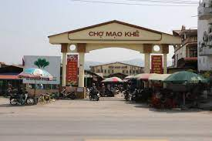
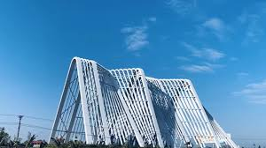

Slide 35
NETWORKS
not enough space
traffic jam
An overcrowded
people

Slide 36
There / not / enough/ space/ children/ play
Traffic jam/ happen
The healthcare/ not/ good
The environment / polluted
5. There/ a shortage / water / electricity/ supply
3. Write
There is not......
Be (not) + enough for somebody to do something
(không) đủ cho ai đó làm gì
There is not enough space for children to pla
Traffic jam happens
The healthcare is not good
7. The environment is polluted

Slide 37
There is not enough space for children to play
Traffic jam happens
3. The healthcare is not good
4.The environment is polluted
5.There is a shortage of water and electricity supplies

Slide 38
Homework
Learn by heart new words and the structure .
Write a passage about disadvantages of an overcrowded school or bus
Prepare unit 12: lesson 5: skills 2

