Slide 1
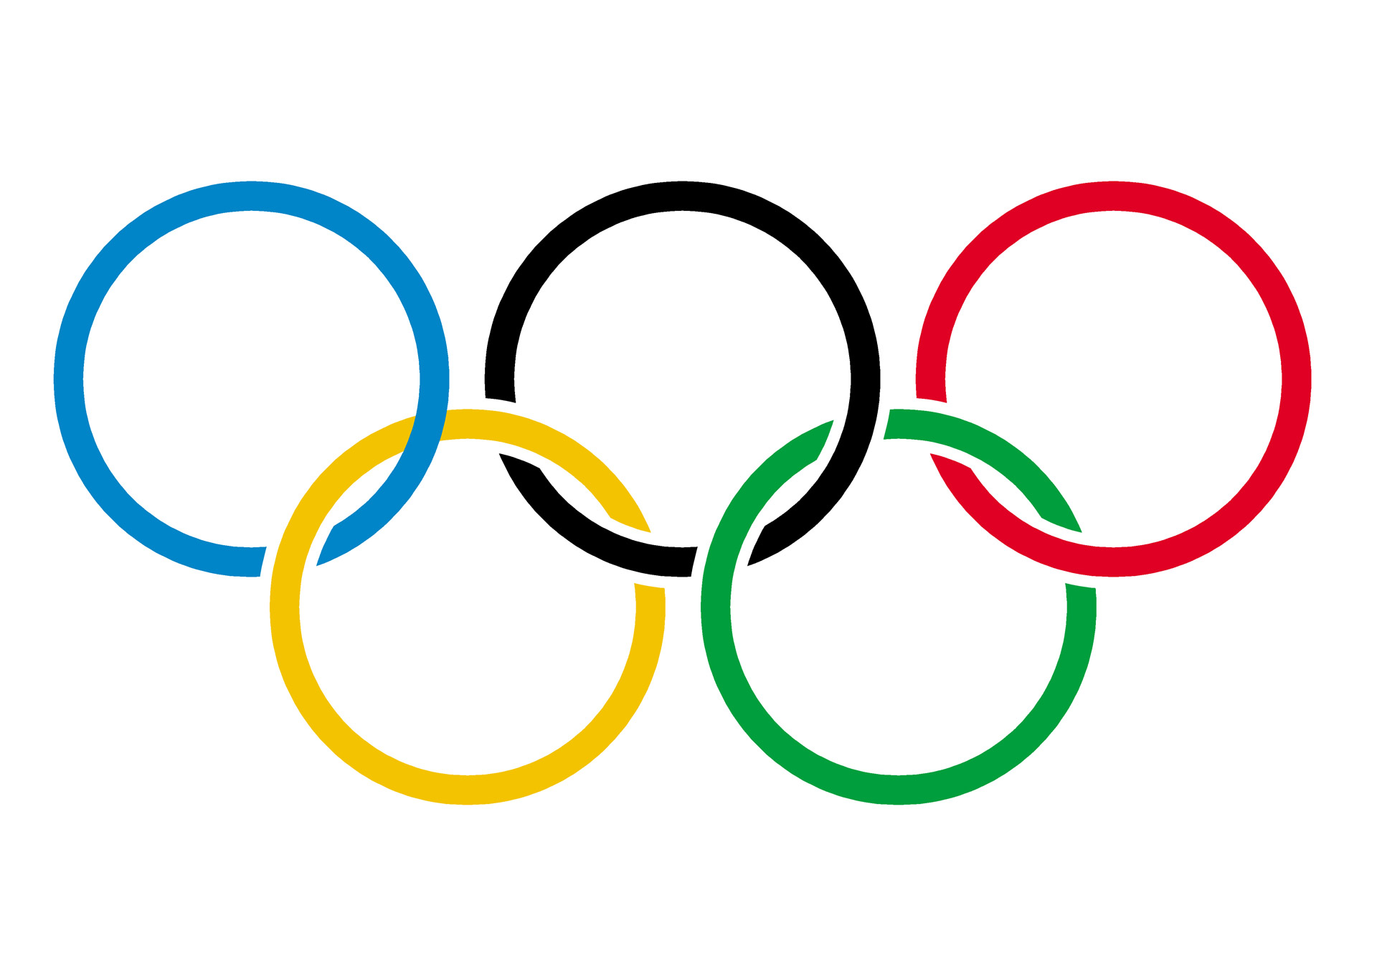
Warm up:
Game: Hidden picture
1
2
3
4
5
6
interlocked rings – Olympic symbol

Slide 2
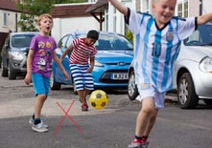
Complete the imperative
________________ in the street.
It’s dangerous.
Don’t play football
Time’s
up
6
3
10
9
8
7
5
4
2
1
Start

Slide 3
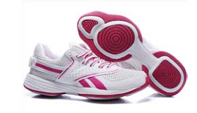
Complete the imperative
Wear sports shoes
________________ when you run.
Time’s
up
6
3
10
9
8
7
5
4
2
1
Start

Slide 4
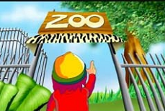
Complete the sentences
Last Sunday Susan _____________________.
went to / visited the zoo
Time’s
up
6
3
10
9
8
7
5
4
2
1
Start

Slide 5
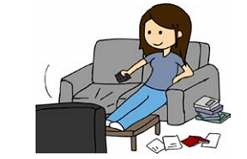
Complete the question
- _____________ TV last night?
- Yes, she did.
Did she watch
Time’s
up
6
3
10
9
8
7
5
4
2
1
Start

Slide 6
Complete the sentence
- I ____ not ____ out last Sunday because it ________
did
go
rained
Time’s
up
6
3
10
9
8
7
5
4
2
1
Start

Slide 7
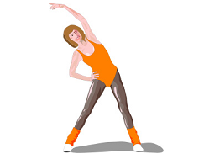
Complete the imperative
__________________ if you want to keep fit.
Do morning exercise
Time’s
up
6
3
10
9
8
7
5
4
2
1
Start

Slide 8
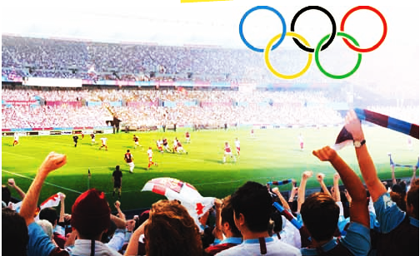
UNIT 8
SPORTS & GAMES-LESSON 4

Slide 9
I. Vocabulary
- fit (a)
- marathon (n)
- ring (n)
- last (v)
- achievement (n)
khoẻ mạnh
cuộc chạy đua ma-ra-tông
đấu trường, sàn đấu
kéo dài (thời gian)
thành tích, thành tựu

Slide 10
Checking vocabulary
- fit (a)
- marathon (n)
- ring (n)
- last (v)
- achievement (n)
khoẻ mạnh
cuộc chạy đua ma-ra-tông
đấu trường, sàn đấu
kéo dài (thời gian)
thành tích, thành tựu

Slide 11
1. Sports quiz: Work in pairs. Do the quiz.
1. How many players are there in a football match?
2. How long does a football match last?
3. How often are the Olympic Games held?
4. Were there Olympic Games in 2011?
5. How long is a marathon?
6. Where were the first Olympic Games held?
7. Which sport happens in a ring?

Slide 12
LUCKY NUMBER
1
9
2
8
3
20
50
60
40
30
10
70
00
20
30
40
00
10
50
60
70
7
4
6
5
NEXT

Slide 13
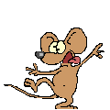
Lucky Number
Lucky Number
BACK

Slide 14
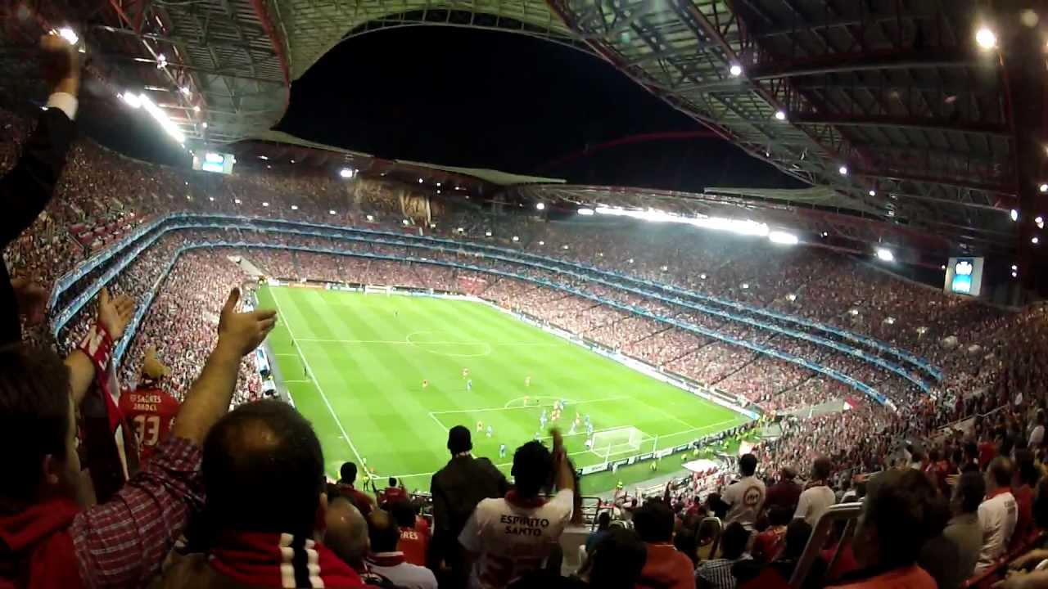
1. How many players are there in a football match?
There are usually 22 players (11 on each side).
BACK

Slide 15
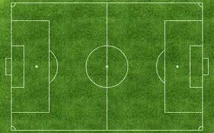
2. How long does a football match last?
It normally lasts 90 minutes (two halves).
BACK

Slide 16
3. How often are the Olympic Games held?
They are held every four years.
BACK

Slide 17
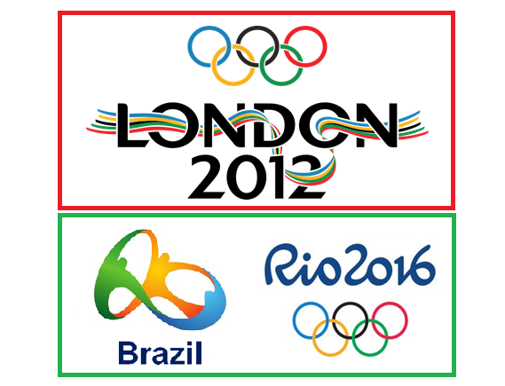
4. Were there Olympic Games in 2011?
No, there weren’t. (They are held in even years)
BACK

Slide 18
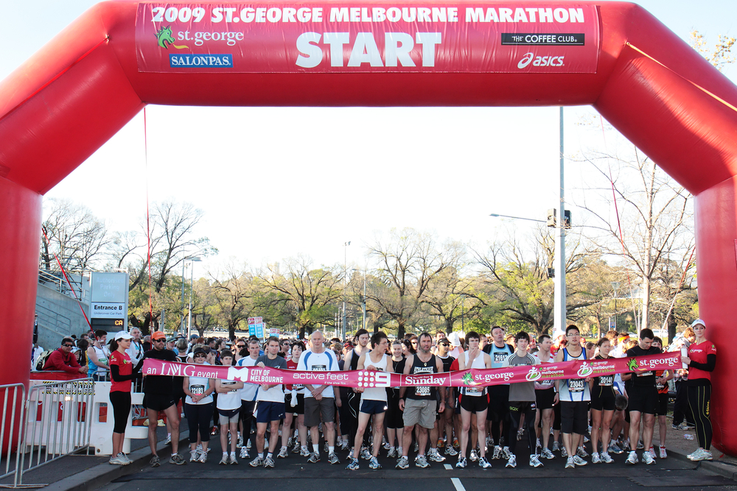
5. How long is a marathon?
It is 42.195 kilometres long (26 miles and 385 yards).
BACK

Slide 19
6. Where were the first Olympic Games held?
They were held in Olympia in Ancient Greece. (in 776 BC)
BACK

Slide 20
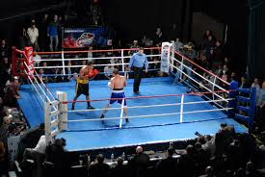
6. Which sport happens in a ring?
(A ring = A rectangular arena set off by stakes and ropes)
Boxing does
BACK

Slide 21
1. Sports quiz: Work in pairs. Do the quiz.
1. How many players are there in a football match?
2. How long does a football match last?
3. How often are the Olympic Games held?
4. Were there Olympic Games in 2011?
5. How long is a marathon?
6. Where were the first Olympic Games held?
7. Which sport happens in a ring?
There are usually 22 players (11 on each side).
It normally lasts 90 minutes (two halves).
They are held every four years.
No, there weren’t. (They are held in even years)
It is 42.195 kilometres long (26 miles and 385 yards).
They were held in Olympia in Ancient Greece. (in 776 BC)
Boxing / Wrestling does.

Slide 22
2. In pairs, interview your partner using the following questions. Ask for more information.
Nam
Questionnaire | Name:…………….
1. What sports/games do you play in your free time?
2. What sports/games do you do at school?
3. Which sports/games do you like watching on TV?
4. Do you think you are fit? Would you like to get fitter?
5. Is there any sport/game you’d like to learn to play well?
6. Can you name three famous sportspersons?
football, badminton, table tennis.
catch, hide-and-seek, marble.
football, boxing, volleyball.
yes.
football.
Pele, Maradona, Messi…

Slide 23
Report model: I interview Nam for his information on sports/games. He plays football, badminton and table tennis in his free time. At school, he often plays catch, hide-and-seek and marbles. He likes watching football, volleyball and boxing. Because Nam likes playing sports / games, so he is very fit. He is trying to get fitter to be able to play football as well as Messi does. Besides Lionel Messi, his sports idols are Pele, Maradona and Cristiano Ronaldo. That’s all.

Slide 24
3. Think of a sportsman/sportswoman you like. Draw a picture of him/her below. Talk about him/her with a partner. Use the following cues:
- his/her name
- the sport he/she plays
- his/her past achievements
- why you like him/her?

Slide 25
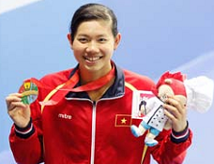
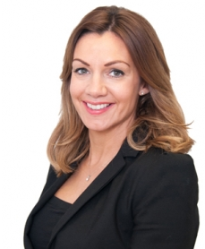
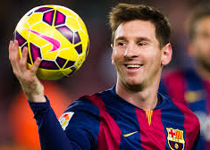
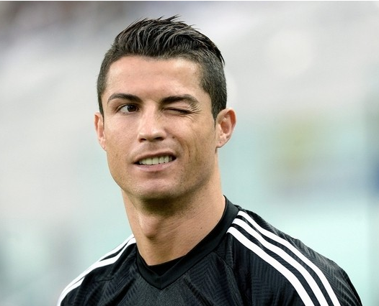
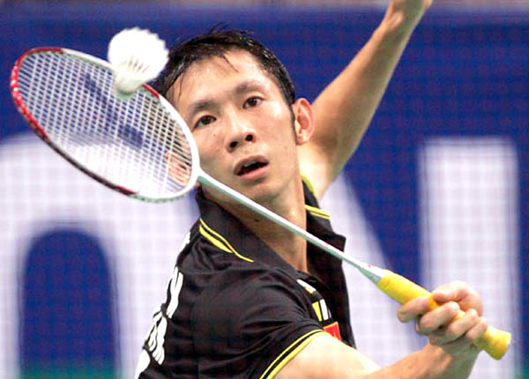
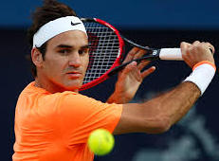
Anh Vien – Swimmer
Rebecca Stevens – Climber
Lionel Messi – Footballer
Cristiano Ronaldo – Footballer
Tien Minh – Badminton player
Roger Federer – Tennis player

Slide 26
Model talk 1: This is Anh Vien. She is a very famous and popular swimmer in Vietnam. She is not only a professional athlete but also a professional official of the Vietnam People’s Army. At the age of 19, she is the youngest captain in the army’s history. At the Singapore SEA Games, Vien won eight gold medals in the women’s 200m backstroke, 200m breaststroke, 200m butterfly, 200m freestyle, 200m individual medley, 400m freestyle, 400m individual medley, and 800m freestyle events. She also won a silver medal in the women’s 100m freestyle event and a bronze in the women’s 50m backstroke category. Anh Vien is now the only ‘billionaire’ (in Vietnamese dong) in the swimming circle in Vietnam, earning prizes worth on average VND500 million (US$23,100) a year since 2013 but she lives a very simple life and she’s also a good daughter at home. She gives most of her income to her parents, who live in her hometown, Can Tho. Her parents admitted that they now have a well-built house and state-of-the-art furniture and other facilities thanks to the money she has sent home. I admire her a lot. She really sets a good example for young generation in Viet Nam.
Click for fig

Slide 27
Model talk 2: Rebecca Stevens was the first woman to climb Mount Everest. Before she went up the highest mountain in the world, she was a journalist and lived in South London.
In 1993, Rebecca left her job and her family and travelled to Asia with some other climbers. She found that life on Everest is very difficult. "You must carry everything on your back," she explained, "so you can only take things that you will need. You can't wash on the mountain, and in the end I didn't even take a toothbrush. I am usually a clean person but there is no water, only snow. Water is very heavy so you only take enough to drink!"
Rebecca became famous when she reached the top of Mount Everest on May 17, 1993. After that, she wrote a book about the trip and people often asked her to talk about it. She got a new job too, on a science programme on television.
Click for fig

Slide 28
Please tell me what you have learnt today.
Yes, through the lesson we can now know the fact of some interesting sports/games. We also talk about our favourite sports celebrities.

Slide 29
HOMEWORK
- Learn the new words by heart.
- Write a short passage about your favourite sportsman/ sportswoman.
- Do exercise D1,2 (pages 13,14) in workbook
- Prepare for Unit 8: SKILLS 1.
+

