Slide 1
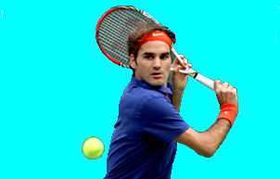
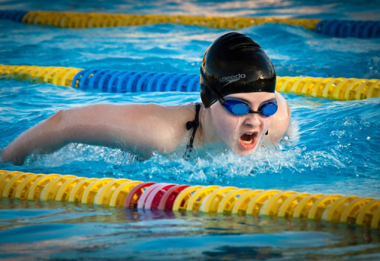
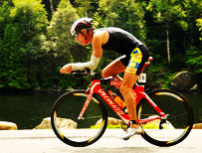
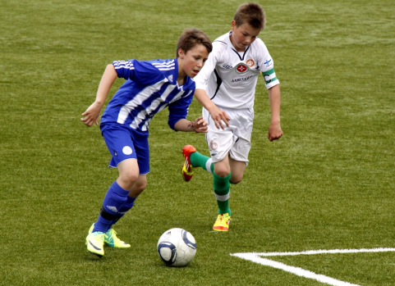
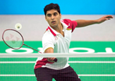
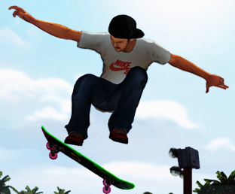
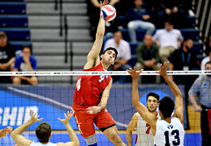
Sports & Games

Slide 2
sailing
skiing
tennis
swimming
cycling
Sports & Games
football
running
badminton
skateboarding
volleyball

Slide 3
UNIT 8
SPORTS & GAMES LESSON 2

Slide 4
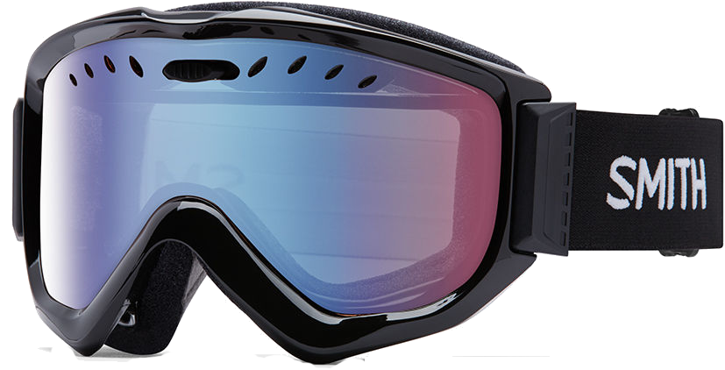
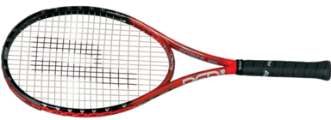
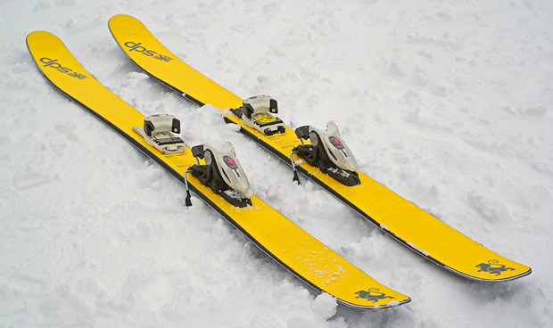
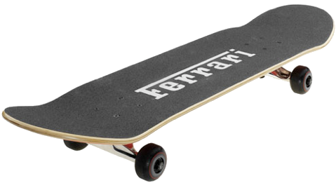
I. New word
- a skateboard (n)
- goggles (n)
- a racket (n)
- skis (n)
ván trượt
kính bảo hộ
cây vợt (tennis, cầu lông)
ván trượt tuyết

Slide 5
- a skateboard (n)
- goggles (n)
- a racket (n)
- skis (n)
ván trượt
kính bảo hộ
cây vợt (tennis, cầu lông
ván trượt tuyết

Slide 6
II. Practice
1. Listen and repeat these words.
1. a ball 5. goggles
2. sports shoes 6. a racket
3. a boat 7. skis
4. a skateboard 8. a bicycle

Slide 7
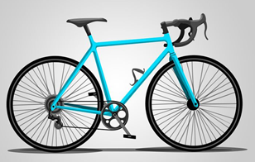
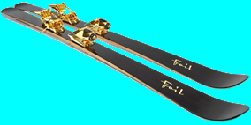
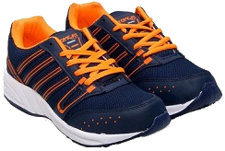
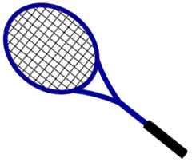
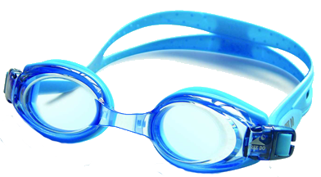
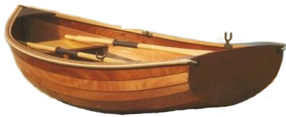
2. Now write the words under the pictures.
a ball
sports shoes
a boat
a skateboard
goggles
a racket
skis
a bicycle
1. _____________ 2. ___________ 3. _______________ 4. _____________
5. _____________ 6. ___________ 7. _______________ 8. _____________

Slide 8
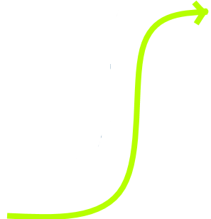
3. What sports are these things for? Match the things in column A with a sport/game in column B.
A
1. bicycle
2. ball
3. sports shoes
4. skis
5. boat
6. skateboard
7. goggles
8. racket
B
a. running
b. swimming
c. cycling
d. ball games
e. skiing
f. tennis
g. sailing
h. skateboarding

Slide 9
III. Pronunciation
/eə/ and /ɪə/
4. Listen and repeat. Pay attention to the sounds /eə/ and /ɪə/.
1. /eə/: where there fair pair prepare
2. /ɪə/: here fear nearly idea volunteer

Slide 10
5. Read the words and say them aloud. Which one has /eə/ or /ɪə/?
/ɪə/
1. A. air B. are C. I’m
2. A. physics B. feather C. aerobics
3. A. stay B. stair C. stadium
4. A. beer B. bird C. born
5. A. show B. share C. shine
6. A. sphere B. spring C. swim
/eə/
/eə/
/ɪə/
/eə/
/ɪə/

Slide 11
6. Listen to the sentences and choose the right words.
1. Fair / Fine play is important in sports.
2. Can you hold / hear me, mum?
3. I haven’t got any idea / fear.
4. The stadium is near the square / statue.
5. Beckham nearly / really missed the ball.
6. The football fans cheered / chased loudly for their side.

Slide 12
Please tell me what you have learnt today.
Yes, through the lesson we can now extend the vocabulary related to the topic ‘Sports and Games’ and practise pronouncing the sounds /eə/ and /iə/ in isolation and in context.

Slide 13
HOMEWORK
- Learn new words by heart.
- Practise saying words that have sounds /eə / and / iə /
- Do exercise A1,2 (page 10) in the workbook.
- Prepare for Unit 8: A closer look 2.
+

