Slide 1
UNIT 1
HOME

Slide 2

LESSON 4

Slide 3
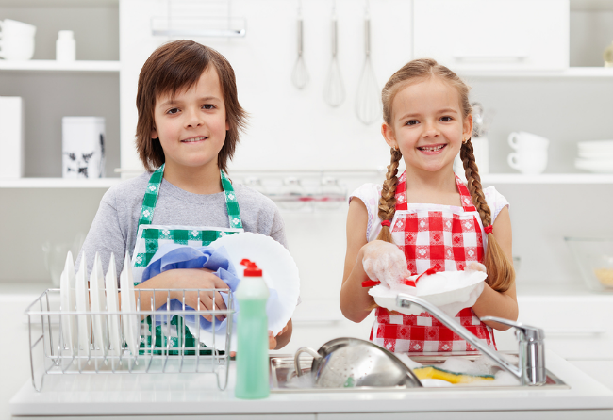

Slide 4
NEW WORDS

Slide 5

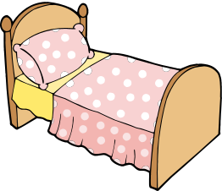
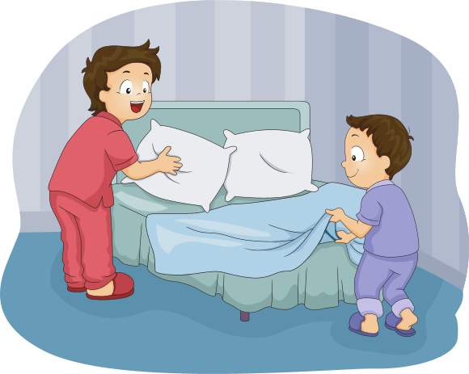
bed (n)
/bɛd/
Cái giường
make the bed (v)
/meɪk ðə bɛd/
dọn giường
We usually make the bed before and after sleeping.
Chúng tớ thường dọn giường trước và sau khi ngủ dậy.

Slide 6
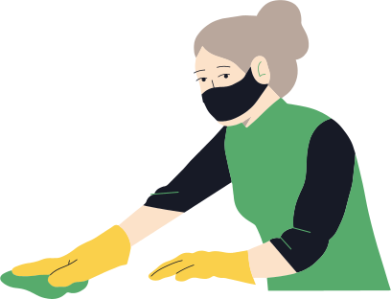
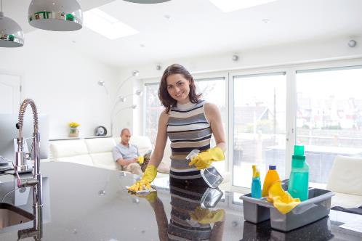
clean (v)
/kliːn/
clean the kitchen (v)
/kliːn ðə ˈkɪʧɪn/
lau chùi nhà bếp
My mother always cleans the kitchen after cooking.
(Mẹ tôi luôn dọn dẹp bếp sau khi nấu nướng.)

Slide 7
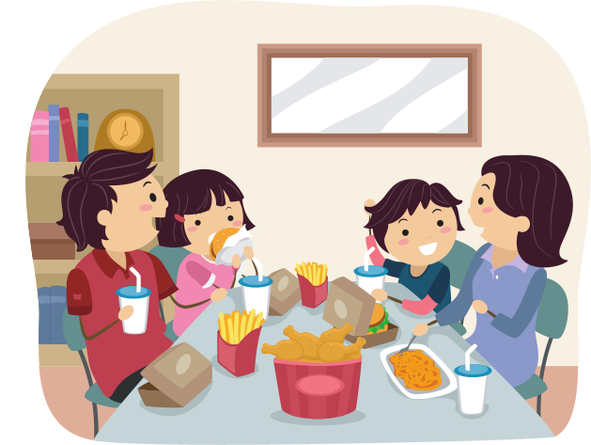
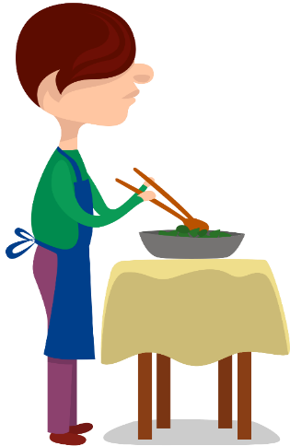
dinner (n)
/ˈdɪnə/
bữa tối
make dinner (v)
/meɪk ˈdɪnə/
nấu bữa tối
My father sometimes cooks dinner at the weekend.
(Cuối tuần bố tớ thỉnh thoảng nấu bữa tối)

Slide 8

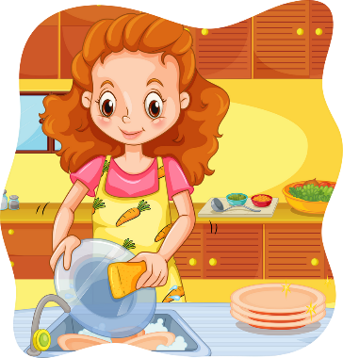
dish (n)
/dɪʃ/
cái đĩa
do the dishes (v)
/duː ðə ˈdɪʃɪz/
rửa bát đĩa
She usually helps her mother to do the dishes after meals.
Cô ấy thường xuyên giúp mẹ rửa bát sau các bữa ăn.

Slide 9
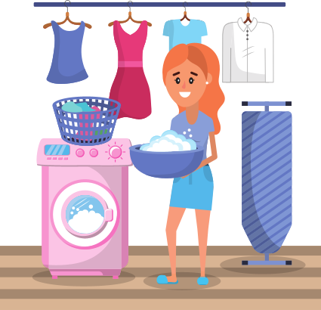

laundry (n)
/ˈlɔːndri/
việc giặt là
do the laundry (v)
/duː ðə lɔːndri /
Who does the laundry in your house?
giặt quần áo
Ở nhà bạn thì ai giặt quần áo?

Slide 10
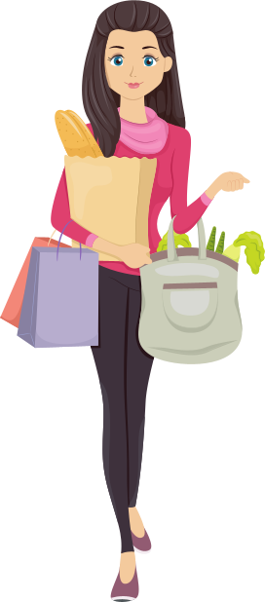
shopping (n)
/ˈʃɒpɪŋ/
việc mua sắm
do the shopping (v)
/duː ðə ˈʃɒpɪŋ/
My mother does the shopping everyday.
đi mua đồ / đi chợ
Mẹ tớ đi chợ hàng ngày.

Slide 11

do the housework (v)
/duː ðə ˈhaʊswɜːk/
làm việc nhà
Who does the most housework in his house?
Ai làm nhiều việc nhà nhất trong nhà anh ấy?

Slide 12
WORD | CLASS | MEANING
make the bed
(phr)
dọn giường
make dinner
(phr)
nấu bữa tối
clean the kitchen
(phr)
lau bếp
do the laundry
(phr)
giặt quần áo
do the dishes
(phr)
rửa bát đĩa
do the shopping
(phr)
đi mua sắm
do the housework
(phr)
làm việc nhà

Slide 13
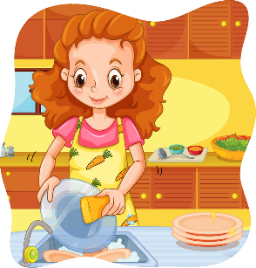
1. What housework does she do everyday?
A. She does the dishes
C. She does the laundry
B. She clean the windows.
D. She makes dinner

Slide 14

2. What housework does she do everyday?
A. She makes the bed
C. She cleans the windows.
B. She cleans the floor
D. She does the laundry

Slide 15
3.What housework does she do everyday?
A. She cleans the windows.
C. She cleans the house.
B. She does the laundry
D. She does the dishes.

Slide 16
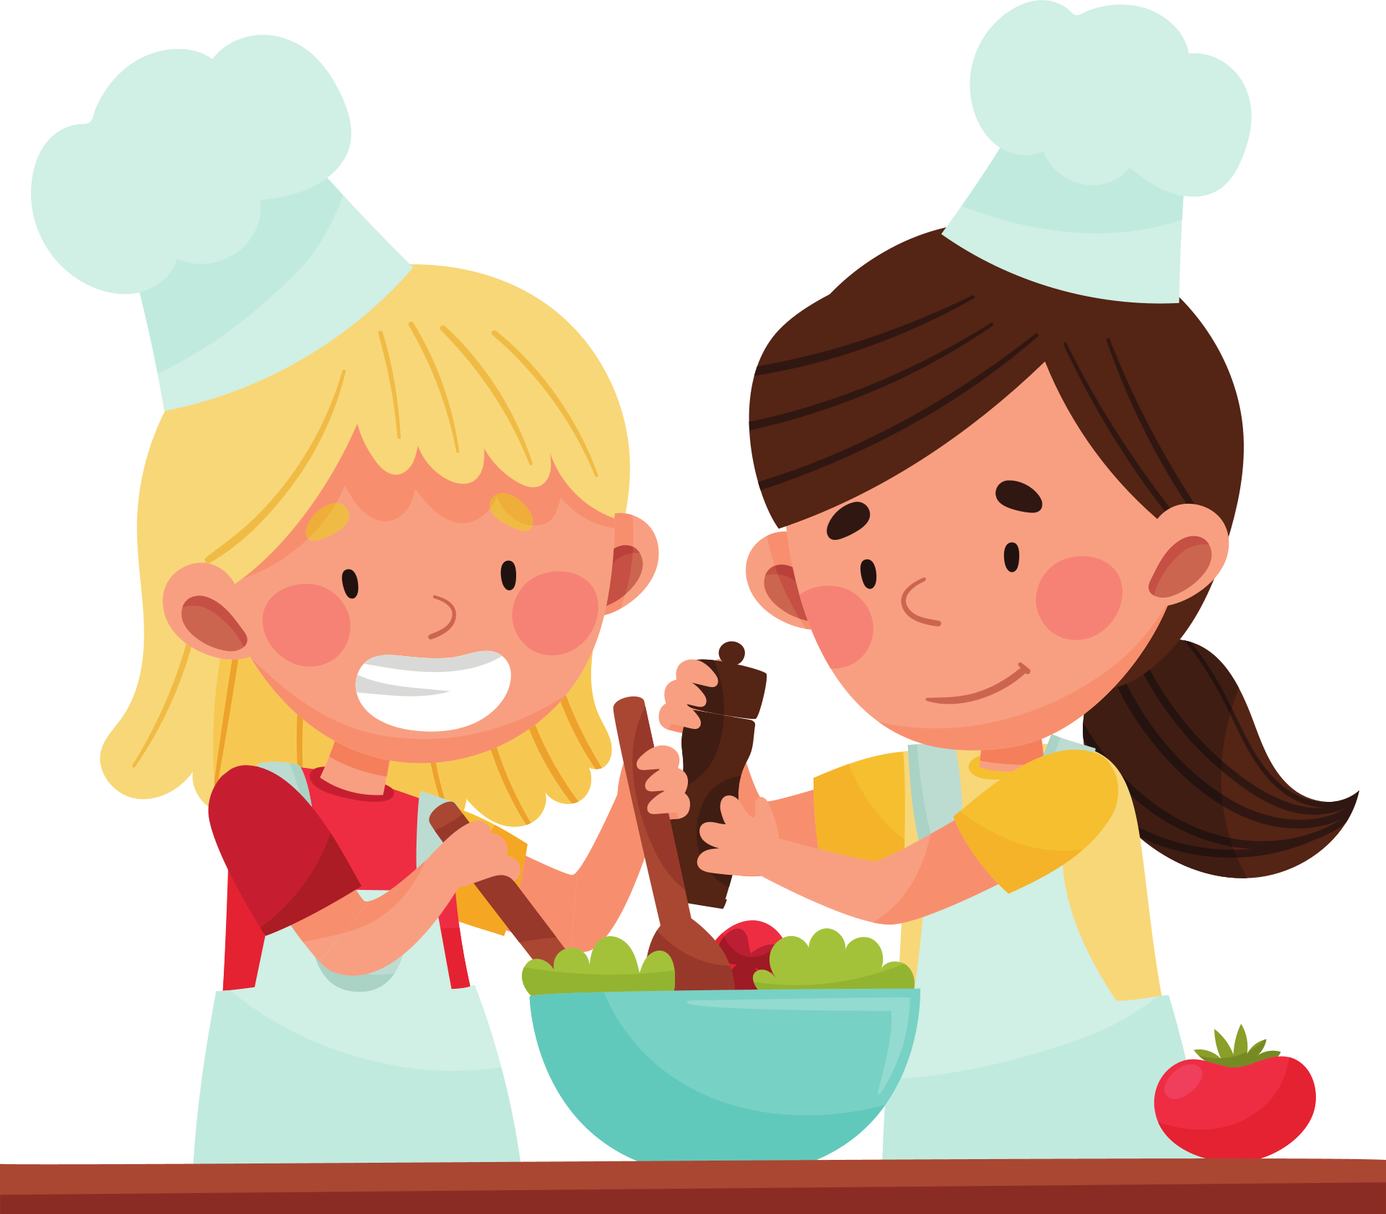
4. What housework do they do everyday?
A. they water the plants
C. They feed the dog
B. They make dinner
D. They do the shopping

Slide 17
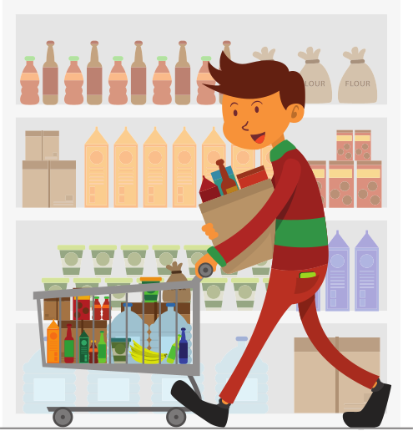
5. What housework does he do everyday?
A. He does the shopping
C. He does the dishes.
B. He walks the dog
D. He does the laundry.

Slide 18
6. What housework does she do everyday?
A. She makes dinner.
C. She does the laundry.
B. She makes the bed.
D. She is washing the clothes.

Slide 19
7. What housework does she do everyday?
A. She does the dishes
C. She does the laundry.
B. She cleans the kitchen.
D. She makes the bed.

Slide 20
8.What housework does she do everyday?
A. He does the shopping.
C. He does the laundry.
B. He cleans the house.
D. He makes the bed.

Slide 21
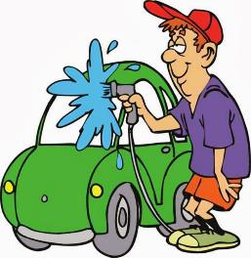
9. What housework does he do everyday?
A. He makes the bed
C. He washes the dishes.
B. He cleans the dishes.
D. He washes the car

Slide 22
10.What housework does she do everyday?
A. She does the shopping.
C. She goes to school.
B. She does the housework.
D. She cleans the kitchen.

Slide 23



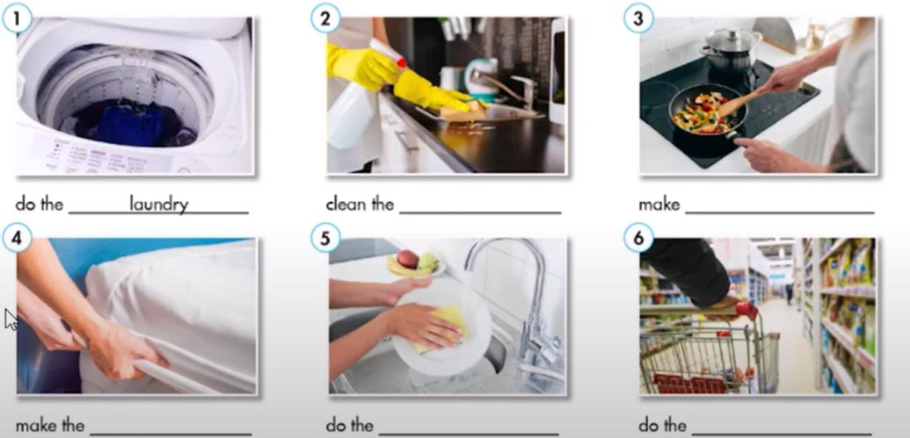
Fill in the blanks. Listen and repeat.
1
2
3
Do the ______________
laundry
Clean the ____________
Make _____________
kitchen
dinner
4
5
6
Make ____________
Do the _______________
Do the_____________
the bed
dishes
shopping

Slide 24
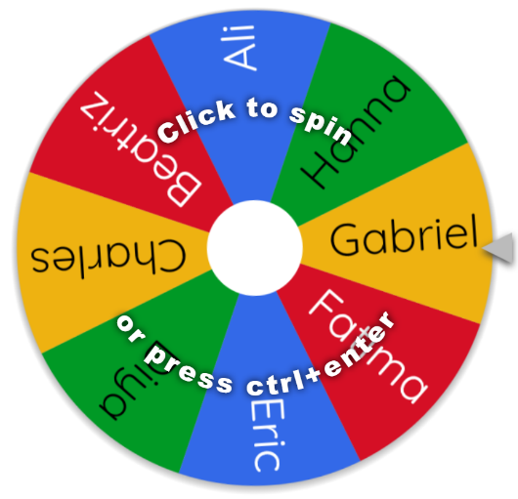

Practice : Say what housework you do at home.
Gợi ý hoạt động game online.
Giáo viên lick vào link. Nhập tên học sinh muốn gọi trong lớp sau đó gọi học sinh lên trả lời các công việc hằng ngày học sinh làm bằng câu hỏi
“ What housework do you do everyday?
BẤM VÀO ĐÂY
https://wheelofnames.com/#

Slide 25

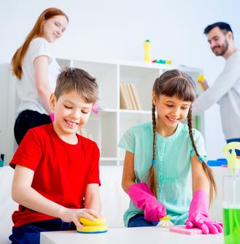
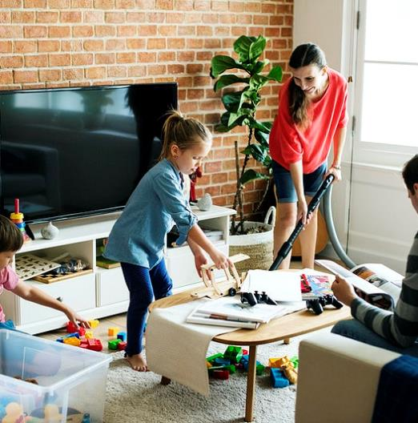
Look at the two pictures answer the questions?
1. What are they doing?
2. What does the father do in the picture A, and picture B?

Slide 26

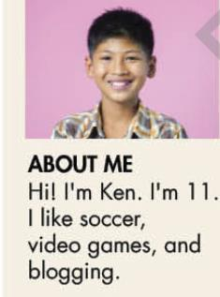
KEN’S CONER a blog about stuff
Housework in My Family
Today I want to talk about housework in my family.
I think I do the most housework in my family. I clean the kitchen every day. I do the dishes, too. My mom does the shopping. She’s a teacher in a school. My sister is a collage student. She doesn’t do anything. She doesn’t make her bed or clean her room. My dad cleans her room after work. He’s a chef in a restaurant so he makes dinner. He does the laundry and cleans the bathroom, too. Hmm. Now, I really think about it, my dad does the most housework.
What housework can you see in the passage?

Slide 27
Read the passage again and circle the correct answer.
1. What does Ken write about?
Housework in My Family
Today I want to talk about housework in my family.
I think I do the most housework in my family. I clean the kitchen every day. I do the dishes, too. My mom does the shopping. She’s a teacher in a school. My sister is a collage student. She doesn’t do anything. She doesn’t make her bed or clean her room. My dad cleans her room after work. He’s a chef in a restaurant so he makes dinner. He does the laundry and cleans the bathroom, too. Hmm. Now, I really think about it, my dad does the most housework.
Ken’s school/ Ken’s family
2. Who does the shopping?
Ken’s sister/ Ken’s mom
3. Who makes dinner?
Ken’s mom/ Ken’s dad
4. Who does the laundry?
Ken’s dad/Ken’s mom
5. Who does the most housework in Ken’s family
Ken/Ken’s dad

Slide 28
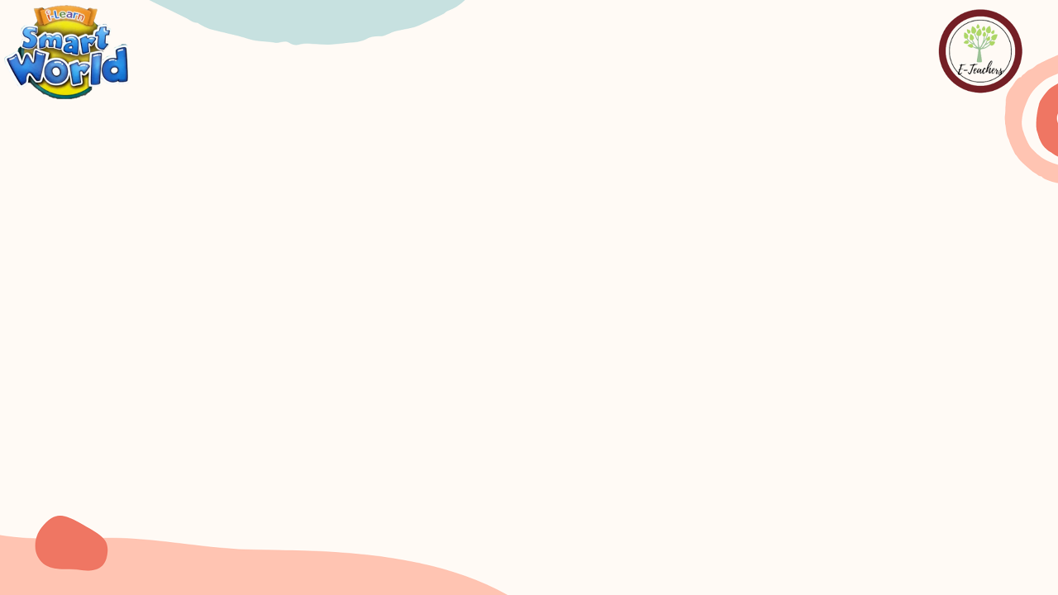
Practice with your partner the conversation and tick to the housework your partner does every day at home
A: What housework do you do everyday ?
B. I do the laudary.
HOUSEWORK | CHECK
Do the dishes
Do the laundry
Make dinner
Clean the kitchen
Do the shopping
Clean the house

Slide 29
HOMEWORK
Learn the new words
Do exercise workbook page (………………….)
Online Practice

